Slide 1
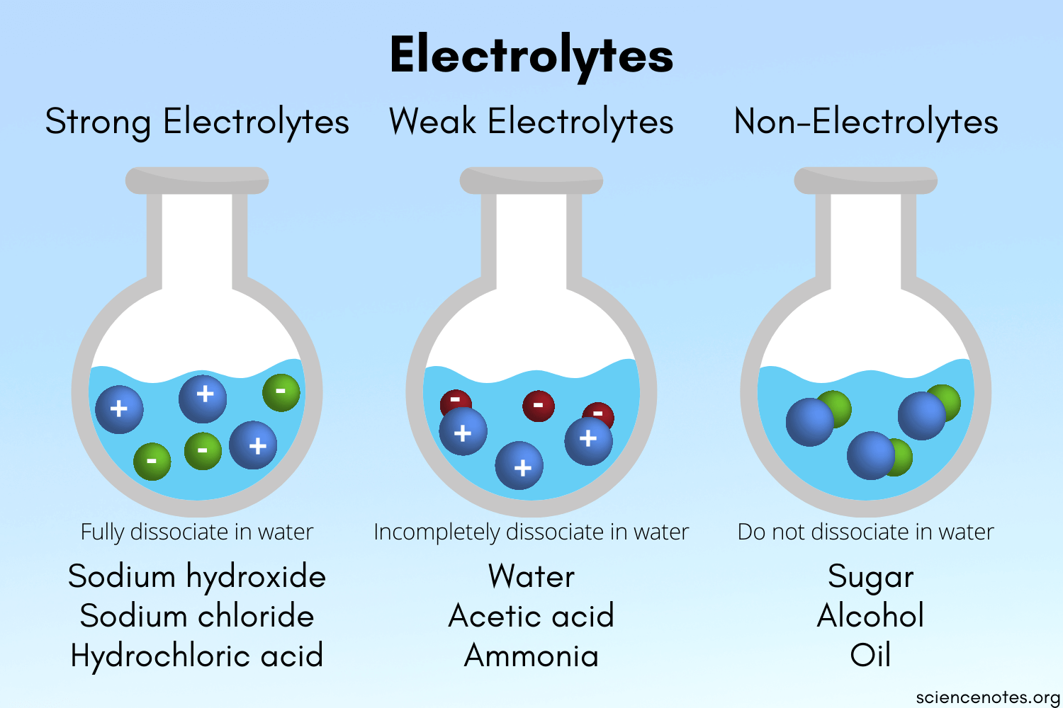

Unit-V
Electrochemistry
Electrochemistry
Notes:
To play the movies and simulations included, view the presentation in Slide Show Mode.

Slide 2
Electrical Conductors
The substances which allow the passage of electric current are called as electrical conductors.
These are of two types, metallic (or) electronic conductors and electrolytic (or) ionic conductors.
Metallic conductors | Ionic conductors
Conductance of these conductors is due to flow of electrons. During the conductance, there is no change in chemical composition of conductor. During the conductance, there is no flow of matter. Metallic conductance decreases with rise of the temperature (resistance increases with temp.). No change of conductance with changing time. Metals, alloys, certain solid salts, amides and Graphite. | Conductance of these conductors is due to flow of ions. During the conductance, there is a change in chemical composition of conductor. During the conductance, there is flow of matter. Ionic conductance increases with rise of the temperature (ionization increases with temp.). Change of conductance with changing time. Electrolytes like Acids (HCl, CH₃COOH), Bases (NaOH, NH₄OH) and Salts (NaCl, CH₃COONH₄).

Slide 3
Electrical Resistance
Property of hindering the flow of electricity is called resistance. For a conductor of uniform cross section (a), length (l) and Resistance (R). Unit of resistant is Ohm
Where ρ is resistivity or specific resistance and its unit are ohms.cm (or) rho.
a
l
Electrical Conductance(C)
The tendency of a substance to allow electric current (or) the reciprocal of resistance is conductance. Units for conductance = ohm⁻¹ (or) mho (or) 𝛀⁻¹. In SI system =Siemens.

Slide 4
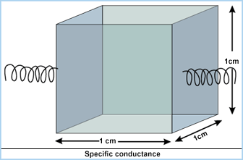
Specific Conductance:
It is the reciprocal of specific resistance.
where
Therefore
Units for k: ohm^{–1}cm^{–1} and SI units : S.m^{–1} ,where S is Siemens
is known as cell constant(x)
Specific conductance mainly useful for metallic conductors, because it depends on length and area of cross section metals.
Ionic conductance depends on concentration of solution and not on length and area of cross section of solution. So the term specific conductance not suitable to express ionic conductance.
Hence for ionic conductor the terms equivalent conductance and molar conductance are introduced.

Slide 5
Equivalent conductance (λ) : Conductance produced from all the ions produced by dissolving one gram equivalent weight of an electrolyte in its solution is equivalent conductance. Units: Ohm⁻¹ gm² eq^{-1.}
If the volume of the solution is Vml, then its equivalent conductance is λ_{v} and out of Vml, the conductance of 1ml the solution is specific conductance.
Hence, equivalent conductance is equal to the product of specific conductance (K) and the volume (V).
Where N = normality of solution
Molar conductance : It is defined as the conductance of all the ions produced by ionization of one mole of an electrolyte when present in Vml of solution.
Units of Molar conductance:-ohm⁻¹cm²mole⁻¹ Where M = molarity of solution
µ = λ x Z where Z = valency

Slide 6
Effect of dilution on Conductance:
Due to dilution, the volume of the solution increases, so the number of ions present in 1cm³ solution is less than that of a concentrated solution. Thus, the specific conductance of the solution decreases.
But on dilution, the equivalent conductivity, and the molar conductivity increase, because of the increase in the degree of dissociation and the total number of ions in the solution.
Dilution (moles / lit)

Slide 7
Difference between electrochemical cells and electrolytic cells
Electrochemical cell | Electrolytic cell
This type of cell converts chemical energy to electrical energy. The cathode is the positive electrode and the anode is the negative electrode. In electrochemical cells, a spontaneous reaction occurs. In an electrochemical cell, half cells are placed in different containers and connected via a salt bridge. In electrochemical cells, electrons go from the anode to the cathode | This type of cell converts electrical energy to chemical energy. The cathode is the negative electrode and the anode is the positive electrode. In electrolytic cells, a non-spontaneous reaction occurs. The electrodes are placed in a similar container and placed in an electrolytic solution. Electrons go from the battery to the cathode, then via the electrolytic solution to the anode in electrolytic cells

Slide 8
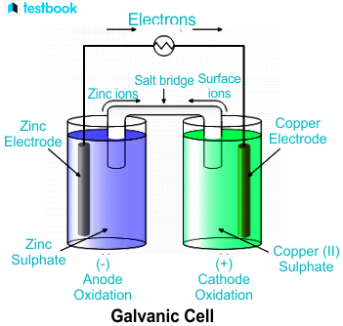
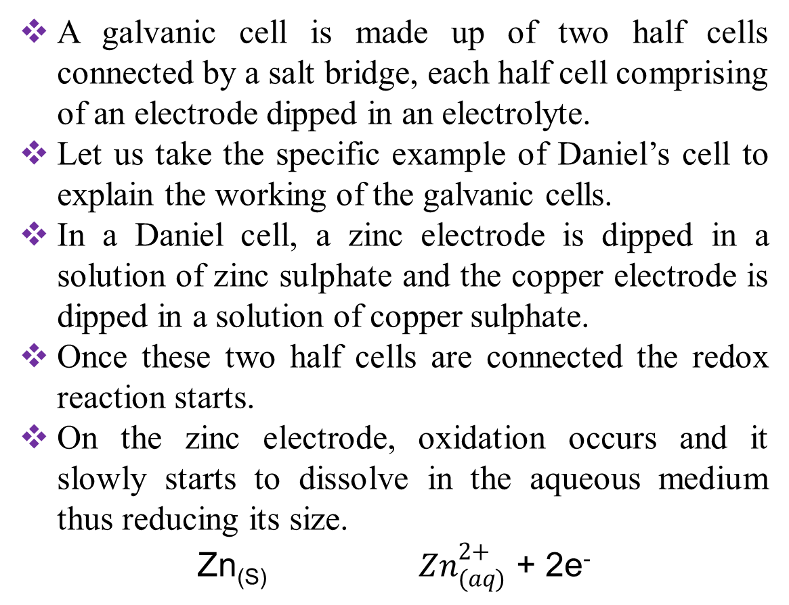
Electrochemical cells (or) Galavanic cell
A galvanic cell is made up of two half cells connected by a salt bridge, each half cell comprising of an electrode dipped in an electrolyte.
Let us take the specific example of Daniel’s cell to explain the working of the galvanic cells.
In a Daniel cell, a zinc electrode is dipped in a solution of zinc sulphate and the copper electrode is dipped in a solution of copper sulphate.
Once these two half cells are connected the redox reaction starts.
On the zinc electrode, oxidation occurs and it slowly starts to dissolve in the aqueous medium thus reducing its size.
${\text{Zn}\text{(}\text{S}\text{) } Zn}_{(aq)}^{2+}$ + 2e⁻

Slide 9

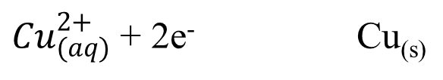
The electrons thus generated in this oxidation half cell, travel via the external circuit and reach reduction half cell.
Here, the copper ions take up those electrons to form a neutral copper atom that ultimately deposits on a copper rod. With time you will see that the cathode rod starts to increase in size.
${Cu}_{(aq)}^{2+}$ + 2e⁻ Cu_{(s)}
The EMF is created by the movement of electrons and thus depends on both electrolyte and electrode. The overall redox reaction is :
Functions of salt bridge:
The salt bridge is used in electrochemical cells to connect the oxidation and reduction half cells of a galvanic cell.
A Salt bridge is used to maintain electrical neutrality inside the circuit of a galvanic cell.
A Salt bridge acts as an electrical connection between two half cells.
A Salt bridge prevents the diffusion of solution from one cell to the other.

Slide 10
Eelectromotive force (EMF)
The potential difference between two electrodes is known as electromotive force(EMF) cell potential.
It can be expressed in terms of both reduction potential and oxidation potential.
Tendency to gain electron(reduction potential) at cathode remains at higher potential. On the other hand , tendency to lose electron(oxidation potential) at the anode remains at higher potential
In terms of reduction potential
E º _{Cell} = E º _{cathode} –E º _{anode}
In terms of oxidation potential
E º _{Cell =} E º _{anode} - E º _{cathode}
EMF of the total cell is equal to the sum of oxidation potential and reduction potential of the right hand electrode minus left hand electrode.
E_{Cell =} E_{R} - E_{L}

Slide 11
Generally electrode potential refers to the reduction potential. For example potentials of Right Electrode is 0.337V and left electrode is -0.763V
E_{Cell =} E_{R} - E_{L} = 0.337-(-0.763) = 0.337+0.76 = 1.1V
Cell formulation, Notation, Representation or Symbol:
Anodic half cell should be represented on the left side & the cathodic half cell should be represented on the right side.
Anodic half cell is represented by writing the symbol of the metal followed by the symbol of the electrolyte with its concentration in the brackets and the two are separated by a vertical line.
Cathodic half cell is represented by writing the symbol of the electrolyte with its concentration in the brackets followed by the symbol of the metal & the two are separated by a vertical line.
A salt bridge is indicated by two vertical lines, separating two half cells.
Example-1: Zn / Zn²⁺ (1M) // Cu²⁺ (1M) / Cu
Example-2: H₂(g) / Pt/H⁺(1M) // Hg⁺²(1M) / Hg (s)

Slide 12

Nernst Equation
M²⁺_{(aq)} + ne⁻ → M_{(S)}
$$∆G =∆G 0+RT ln\frac{[Products]}{[Reactants]} since ∆G =−nFE and ∆G 0=−nFE 0$$
$$−nFE = −nFE 0+ RT ln \frac{\left[Products\right]}{\left[Reactants\right]} Dividing with –nF on both side$$
$E=E^{0}− \frac{RT}{nF}$ ln $\frac{[Products]}{[Reactants]} E=E^{0}− 2.303\frac{RT}{nF}$ $log\frac{[Products]}{[Reactants]}$
$$At {25}^{o} T = {298}^{o} K, R = 8.314 J {JK}^{−1}mole−1, F = 96500 coulombs.$$
$$E=E^{0}− \frac{0.0591}{n}log\frac{[Products]}{[Reactants]} for pure solids, activity is unity$$
$$E=E^{0}− \frac{0.0591}{n}log\frac{1}{[Reactants]}$$
The theoretical relation ship b/w the electro chemical reaction and the corresponding cell e.m.f, this relation ship is generally known as Nernst equation.

Slide 13

aA + bB → cC + dD
E_{cell} = E ⁰_{cell} - $\frac{0.0591}{n}$ log $\frac{[ {C]}^{c}{\left[D\right]}^{d}}{{ [A]}^{a }{\left[B\right]}^{b}}$
Here E_{cell} = EMF of the cell, R= gas constant, T = Absolute Temperature, n= Number of electrons involved in reaction F= no. of faradays of current passed, K = equilibrium constant
Nernst Equation Applications
The Nernst equation can be used to calculate the following:
Single electrode reduction or oxidation potential at any conditions.
Standard electrode potentials.
Comparing the relative ability as a reductive or oxidative agent.
Finding the feasibility of combining such single electrodes to produce an electric potential.
EMF of an electrochemical cell.
Unknown ionic concentrations.
The pH of solutions and solubility of sparingly soluble salts can be measured with the help of the Nernst equation.

Slide 14
Electrochemical series (or) galvanic series
When the metals are arranged in the increasing order of their reduction potentialsor decreasing of their oxidation potentials, the resulted series is called electrochemical series.
Reduction potentials increasing order:-
Li < K < Ca < Na < Mg < Al < Zn < Fe < Cd < Pb < H₂/Pt < Cu < Ag < Au.
Metals higher in the series are reducing agents and lower in the series are oxidizing agents.
Any metals above the series will displace hydrogen from dilute acid.
Ex: Na +H₂O⟶NaOH+1/2H₂
Any metal ion below the hydrogen will reduce by the hydrogen.

Slide 15
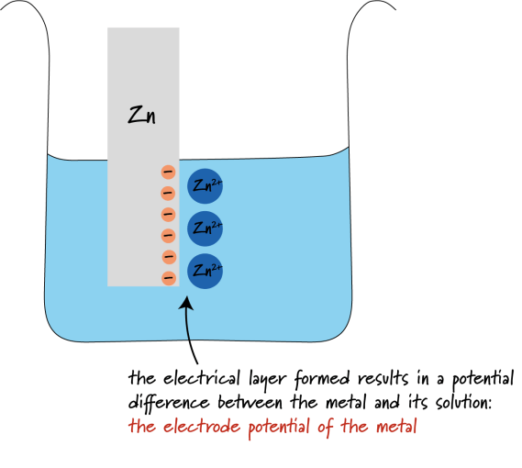
Single electrode potential
Single electrode potential is defined as the potential generated when the metal is dipped in the solution consisting of its own ions, at the interphase between solution and metal.
Apparently, it is not possible to determine the single electrode potential because the half-cell reactions do not occur independently.
Zn | ZnSo₄ || CuSo₄ | Cu
(Single electrode ) (Single electrode)
However, in practices it is not possible to calculate single electrode potentials. Because single electrode potentials depends on concentration of ions and temperature. However, these are changing during the cell reaction.
The single electrode potential is measured by combining the half-cell with standard electrode.

Slide 16
Reference (or) Standard Electrodes
Electrodes whose potentials are known and by which we can calculate potential of other unknown electrodes are Reference electrode. These are classified into:
Primary reference electrode:- Standard hydrogen electrode (SHE) is primary reference electrode, which is used to calculate potentials of all other electrodes. Standard hydrogen electrode potentials have been taken as zero at all temperature.
Secondary reference electrodes:- Reference electrodes whose potential is determine with help of standard hydrogen electrodes are called secondary standard electrodes. Potentials of secondary reference electrodes are not equal to zero.
Ex:- Calomel electrode ,Quinhydrone electrode ,Glass electrode.
Classification of electrodes :
Metal-metal insoluble salt electrode(Calomel electrode)
Redox electrode(Quinhydrone electrode)
Ion selective Electrode(Glass electrode).

Slide 17
Saturated Calomel Electrode (SCE)
Calomel electrode is commonly used as secondary reference electrode for potential measurements.
SCE consists of a metal, an insoluble salt of that metal and a solution of a soluble salt with common anion (Metal – Metal insoluble salt electrode).
It consists of a glass vessel having a bent side tube.
Pure mercury is placed at the bottom of the tube, which is covered with a paste of mercury- mercurous chloride (Hg &Hg₂Cl₂) that is calomel.
The remaining portion of the cell is filled with a solution of normal (1 N) or saturated Potassium chloride.
A platinum wire sealed into a glass tube is dipped into a mercury layer and is used to provide external electrical contact.
The side tube is used for making electrical contact with a salt bridge.
The calomel electrode can act as an anode or cathode depending on the nature of another electrode of the cell.

Slide 18
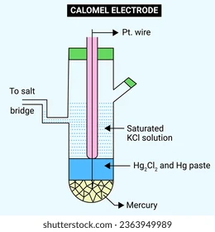
If Calomel electrode acts as anode, the electrode reaction is :
If Calomel electrode acts as cathode, the electrode reaction is :
Hg₂Cl₂ + 2e⁻ → 2Hg + 2 Cl⁻
The Nernst equation for calomel electrode will be
E_{Hg2Cl2|Cl}⁻ = E⁰ _{Hg2Cl2|Cl}⁻ – 2.303RT/2F log [Cl⁻]²
= E⁰ _{Hg2Cl2|Cl}⁻ – 0.0591 log [Cl⁻] at 25 ⁰C
Calomel electrode notation:
Hg / Hg₂Cl_{2(s)} / KCl (Saturated Solution) //

Slide 19
Measurement of P^{H} using Calomel Electrode:
When connected to Hydrogen Electrode, the p^{H} of an unknown solution can be determined using calomel electrode.
When saturated calomel electrode is connected through the potentiometer to standard hydrogen electrode dipped in the solution whose p^{H} is to be determined,
Pt, H₂(1atm)/ H⁺(unknown) // KCl (saturated) │Hg₂Cl₂(s) / Hg ⁺
The EMF of the cell is:
E_{cell} = E_{cathode} - E_{anode} (Since E_{H}⁺_{/H2} ⁼ – 0.0591 p^{H})
E_{cell} = 0.2422 – (-0.0591 p^{H})
E_{cell} = 0.2422 + 0.0591 p^{H}

Slide 20
The electrode potential of calomel electrode depends on the concentration of KCl used.
The potential for saturated KCl solution is 0.2422V.
Advantages:-
Simple to Construct.
Cell potential does not vary with temperature.
The cell potential is reproducible and constant over a long period.
Applications:
It is used as secondary reference electrode in the measurement of single electrode.
It is used as reference electrode in all potentiometer determinations.
The SCE is used in pH measurement

Slide 21
Quinhydrone Electrode
The Quinhydrone electrode is a type of Reversible redox electrode.
This can be used to measure the pH of a solution and an alternative to glass electrode.
The electrode consists of a platinum wire dipped in a solution saturated with Quinhydrone.
Quinhydrone is a 1:1 molar mixture of quinone and hydroquinone.
The electrode solution is with two chemical species in different oxidation states.
Quinone is oxidant, and hydroquinone is reductant in this reaction.
The transfer of electrons between the species takes place through the inert material.
The electrode reaction is:

Slide 22
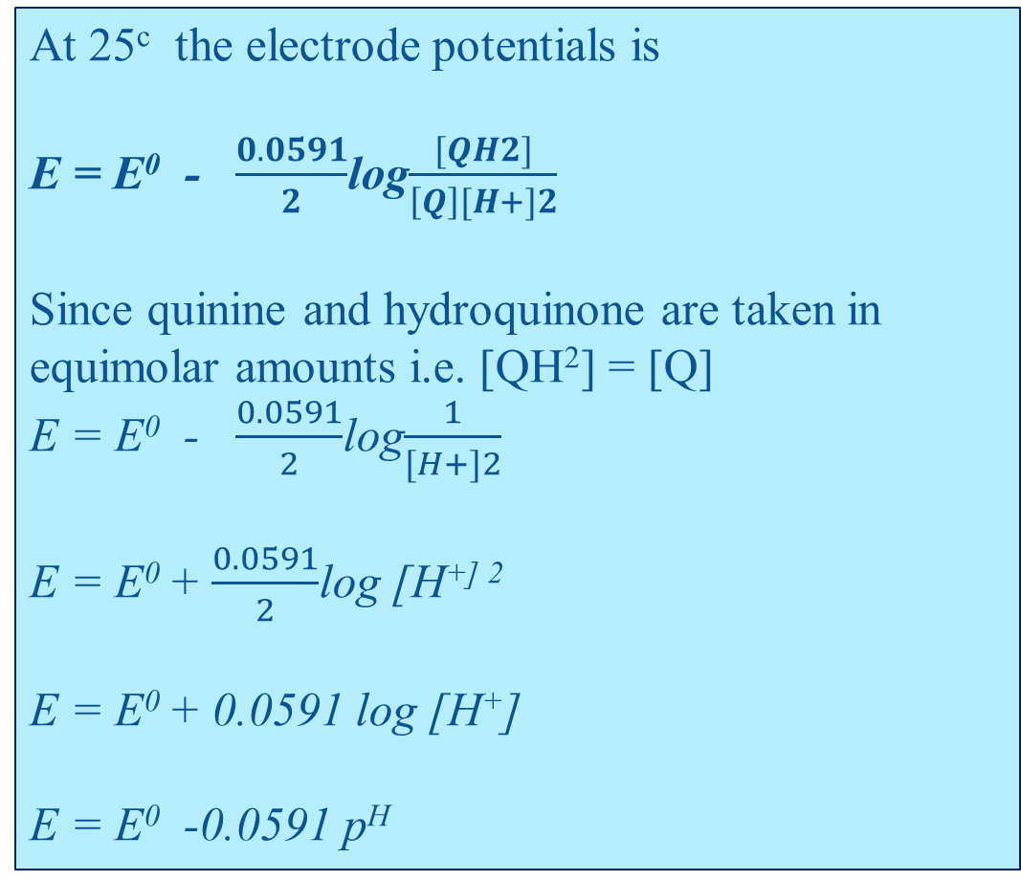
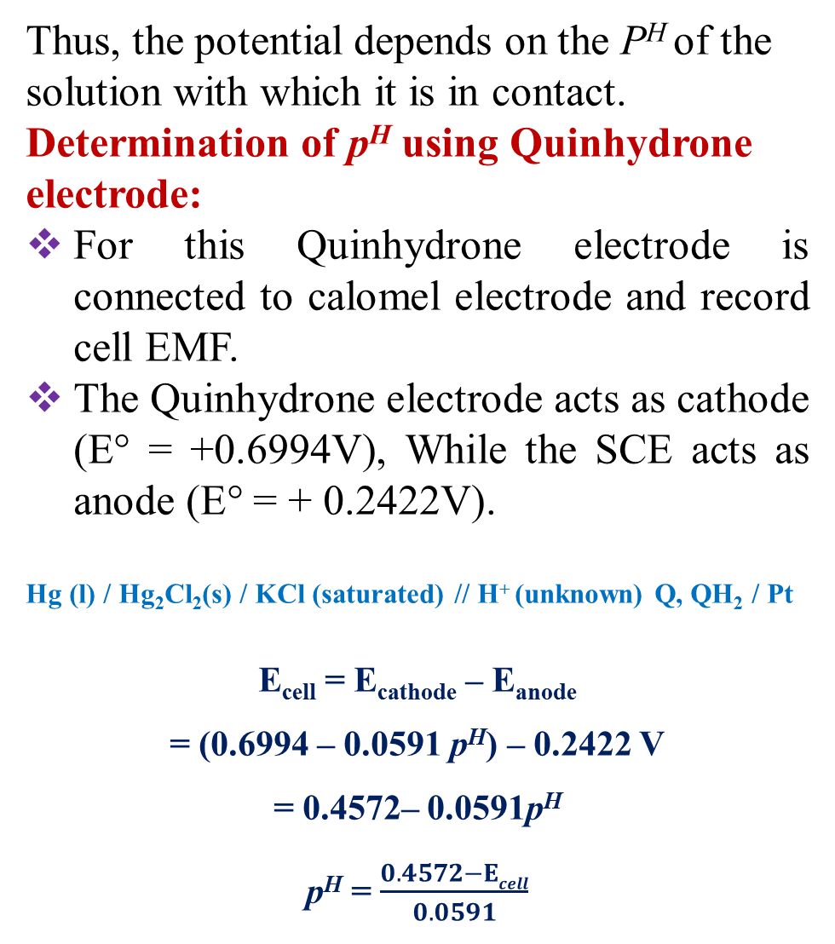
Q + 2H⁺ + 2e⁻ → QH₂
(quinone) ( hydroquinone)
Thus, the potential depends on the P^{H} of the solution with which it is in contact.
Determination of p^{H} using Quinhydrone electrode:
For this Quinhydrone electrode is connected to calomel electrode and record cell EMF.
The Quinhydrone electrode acts as cathode (E° = +0.6994V), While the SCE acts as anode (E° = + 0.2422V).
Hg (l) / Hg₂Cl₂(s) / KCl (saturated) // H⁺ (unknown) Q, QH₂ / Pt
E_{cell} = E_{cathode} – E_{anode}
= (0.6994 – 0.0591 p^{H}) – 0.2422 V
= 0.4572– 0.0591p^{H}
p^{H} = $\frac{0.4572−Ecell}{0.0591}$
At 25^{c} the electrode potentials is
E = E⁰ - $\frac{0.0591}{2}$log$\frac{[QH2]}{\left[Q\right][H+]2}$
Since quinine and hydroquinone are taken in equimolar amounts i.e. [QH²] = [Q]
E = E⁰ - $\frac{0.0591}{2}$log$\frac{1}{[H+]2}$
E = E⁰ + $\frac{0.0591}{2}$log [H^{+] 2}
E = E⁰ + 0.0591 log [H⁺]
E = E⁰ -0.0591 p^{H}
P^{H} = -log [H⁺]

Slide 23
Advantages:
It is very useful for Acid – Base titrations.
Equilibrium is rapidly attained.
It can be used in presence of ions of many metals (Zn, Pb, Cu, Sn, Ni etc.) which affect hydrogen electrode.
It has low internal resistance.
It is simple & free of errors due to the presence of non – reducing gases or salts.
Very small quantities of solution are sufficient for the measurement.
Disadvantages:
It cannot be used in solutions of pH > 8, since hydroquinone ionizes.
It is also oxidized by atmospheric oxygen.
It cannot be used in solutions containing Redox systems.
It is not stable for a long time (above 30º C)

Slide 24
Ion Selective Electrodes (ISE)
The electrodes which have the ability to respond to certain specific ions and develop a potential with respect to that species only in a mixture are called ‘Ion Selective Electrodes’.
These electrodes use a membrane which is sensitive to particular chemical species. These are also referred to as ‘membrane electrodes’.
Ex: Glass membrane is H⁺ ion selective only and does not respond to any other ion.
Glass Electrode
It consists of glass bulb made up of special type of glass called Corning glass (22% Na₂O, 6% CaO, and 72% SiO₂).
It has low melting point and high electrical conductivity.
The glass bulb is filled with 0.1 M HCl solution.
A silver wire coated with AgCl is immersed in it. Ag/AgCl acts as internal reference electrode.
Glass electrode is represented as Ag | AgCl (s) | HCl (0.1M) | glass.

Slide 25
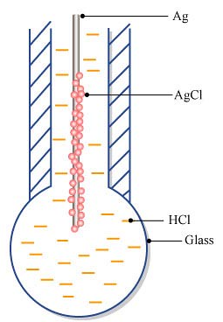
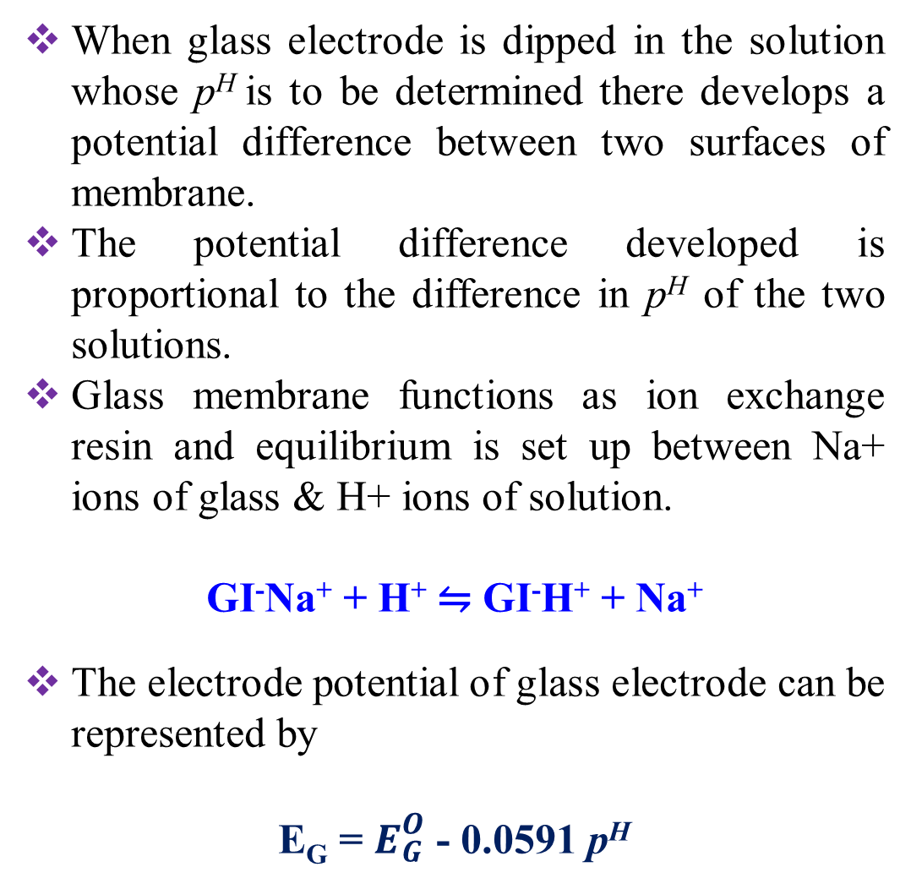
When glass electrode is dipped in the solution whose p^{H} is to be determined there develops a potential difference between two surfaces of membrane.
The potential difference developed is proportional to the difference in p^{H} of the two solutions.
Glass membrane functions as ion exchange resin and equilibrium is set up between Na+ ions of glass & H+ ions of solution.
GI⁻Na⁺ + H⁺ ⇋ GI⁻H⁺ + Na⁺
The electrode potential of glass electrode can be represented by
E_{G} = $E_{G}^{O}$ - 0.0591 p^{H}

Slide 26
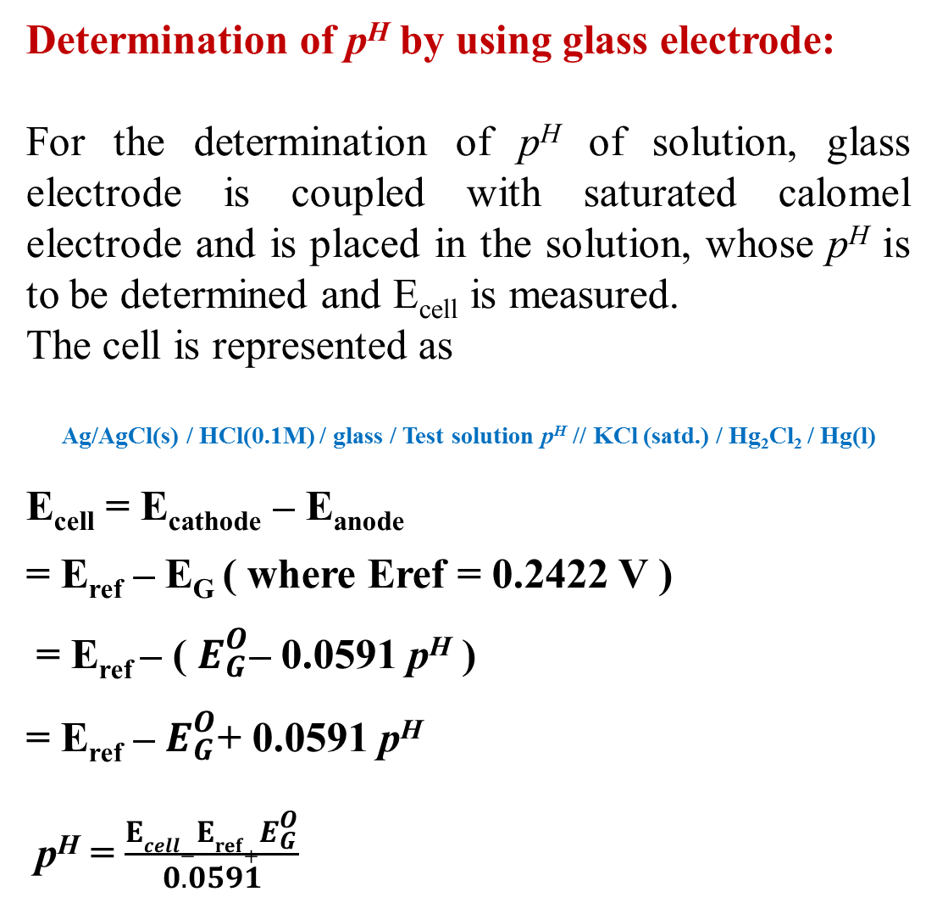
Determination of p^{H} by using glass electrode:
For the determination of p^{H} of solution, glass electrode is coupled with saturated calomel electrode and is placed in the solution, whose p^{H} is to be determined and E_{cell} is measured.
The cell is represented as
Ag/AgCl(s) / HCl(0.1M) / glass / Test solution p^{H} // KCl (satd.) / Hg₂Cl₂ / Hg(l)
E_{cell} = E_{cathode} – E_{anode}
= E_{ref} – E_{G} ( where Eref = 0.2422 V )
= E_{ref} – ( $E_{G}^{O}$– 0.0591 p^{H} )
= E_{ref} – $E_{G}^{O}$+ 0.0591 p^{H}
p^{H} = $\frac{Ecell−Eref+E_{G}^{O}}{0.0591}$
Advantages
Glass electrode is simple & easy to operate.
Equilibrium is rapidly attained.
The results are accurate and is not easily poisoned.
It can be used in coloured, turbid or in colloidal solutions.
It can be used both in alkaline and oxidizing solutions.
Limitations :
As the resistance of glass electrode is high, Electronic potentiometers are required.
It is used up to a p^{H} range of 0-10.
If p^{H} >10, glass is attacked by an alkaline solution.

Slide 27
Battery
The battery is a device consisting of one or more electrochemical cells connected with one another in a series that converts stored chemical energy into electrical energy.
Batteries are broadly divided into 3 types:
Primary Battery (or Primary cell): The battery in which the cell reaction is not reversible is called ‘a primary cell’.
Ex: Dry Cell (Laclanche cell), Lithium Cell etc.
Secondary Battery (or Secondary cell): The battery in which the cell reactions are reversible is called ‘a secondary cell.
Ex: Lead-Acid battery, Lithium ion cell etc.
Flow Battery (or Fuel cell): It is an electro chemical cell that converts chemical energy into electrical energy, in which materials (reactants, products, electrolytes) pass through the battery. Ex: Methanol-Oxygen fuel cell, hydrogen-oxygen fuel cell etc.

Slide 28
Differences between Primary, Secondary and Fuel cells
Primary cell | Secondary cells | Fuel Cell
It acts as a simple galvanic cell. Cell reaction is not reversible. Cannot be recharged. Can be used as long as the materials are active in their composition. Examples are Leclanche or dry cell and Lithium cells. Applications: Radios, torches, transistors, hearing aids. | It acts as a galvanic cell while discharging and electrolytic cell while charging. Cell reaction can be reversed. Can be recharged Can be used again and again by recharging the cell. Examples are Lead storage cell, Lithium ion battery and Nickel cadmium battery. Applications: Electronic calculators, electronic flash units & cordless electronic shavers. | It acts as a simple galvanic cell. Cell reaction is not reversible. Do not store energy. Energy can be withdrawn indefinitely as long as outside supply of fuel. Examples are H₂-O₂ and CH₃OH-O_{2.}fuel cells Applications: Space vehicles.

Slide 29
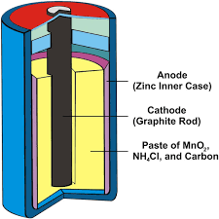
Zinc Carbon battery or Dry cell (Leclanché Cell)
The Leclanché cell is a battery invented and patented by the French Scientist Georges Leclanche in 1866.
This cell is known as ‘dry cell’ because of the absence of any mobile or liquid phase.
It is a cell without fluid component is perhaps the most familiar of all batteries.
The anode of the cell is Zinc container containing an electrolyte consisting of NH₄Cl, ZnCl_{2,} MnO₂ to which starch is added to make it thick paste.
A carbon rod (graphite) serves as a cathode, which is immersed in the electrolyte in the centre of the cell.
The Zn-MnO₂ or dry cell is represented as :
Zn / Zn²⁺, NH₄ ⁺/ MnO₂ / C

Slide 30
The cell reactions:
At anode(Oxidation ): Zn(s) → Zn⁺²(aq) + 2e⁻
At cathode(Reduction): 2MnO₂(s) + H₂O + 2e⁻ → Mn₂O₃(s) + 2OH –
The net cell reaction: Zn(s) + 2MnO₂(s) +H₂O → Zn (OH)₂+ Mn₂O₃
However, accumulation of negative charge (OH⁻ ) at cathode and positive charge (NH₄⁺) at anode disrupts the current flow.
This prevented by following over all reactions:
Hence the reaction at two electrodes are, Anode: Zn(s) → Zn²⁺ (aq) + 2e⁻
Cathode: 2MnO₂(s) + 2NH₄Cl(aq) +2e⁻ → Mn₂O₃(s) +2NH₃(aq)+H₂O(l)+2Cl⁻ (aq)
Net : Zn(s) + 2NH₄⁺(aq) +2Cl⁻ (aq) + 2MnO₂ (s) → Mn₂O₃(s) + [Zn(NH₃₎₂]Cl₂ (s) +2H₂O (l)
Since the reactions involved cannot be reversed by passing electricity back through the cell, it cannot be rechargeable.

Slide 31
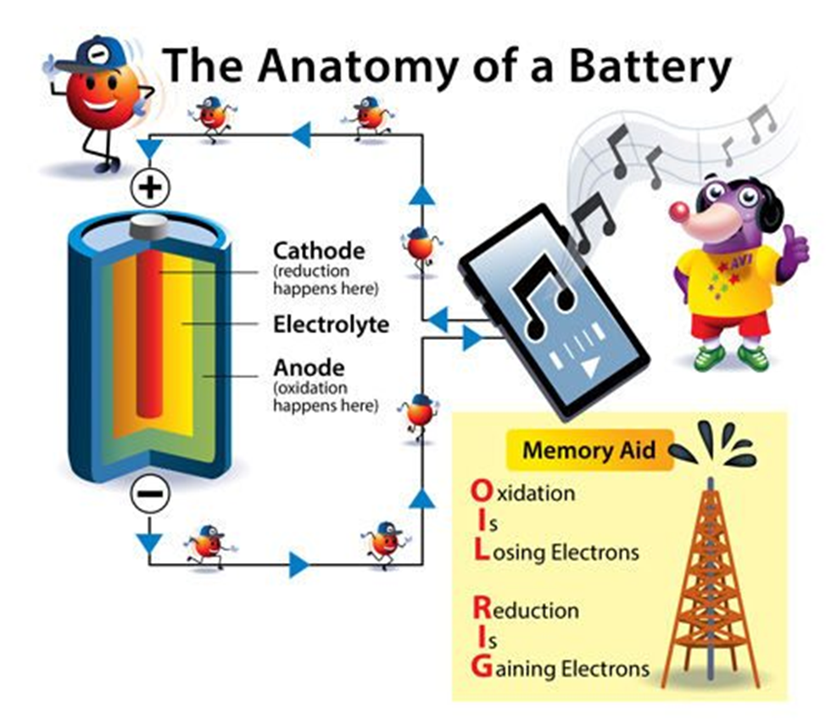
Advantages
It is cheap to make & gives voltage of about 1.5V
Disadvantages
If current is rapidly drawn from it, products buildup on the electrodes there by causing drop in voltage.
Since the electrolytic medium is acidic, so Zinc metal dissolves slowly, there by the cell run down slowly, even if it is not in use.
Uses
Dry cells are used in flashlights, transistor radios, calculators etc.

Slide 32
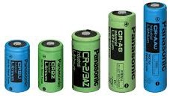
Lithium cells
Lithium cells are primary cells in which lithium acts as anode and the cathode may differ.
Lithium metal is used as anode because of its light weight, high standard oxidation potential.
Reactivity of lithium in aqueous solution is more, so non-aqueous solvents used for solutes.
Lithium cells are classified into two categories:
Lithium cells with solid cathode:
Anode: Lithium Metal,
Cathode: MnO₂ as an active material.
Electrolyte: LiBF₄ salt in non aqueous solvents.
Reactions: At anode: Li⟶ Li⁺ + e⁻
At cathode: e⁻ + MnO₂ ⟶ MnO₂⁻
Net reaction: Li + MnO₂⟶ LiMnO₂
Applications: The coin type cells are used in watches and calculators.
Cylindrical cells are used in fully automatic cameras.

Slide 33
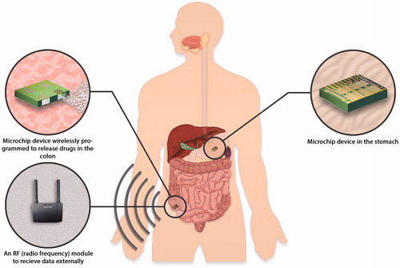
Lithium cells with liquid cathode:
Anode : Li
Cathode : SOCl₂
Electrolyte : LiAlCl₂
Anode : 4Li →4Li⁺ +4 e⁻
Cathode : 4Li⁺ + 4e⁻ +2 SOCl₂ → 4 LiCl + SO₂ + S
Overall reaction : 4Li⁺ + 2SOCl₂ → 4 LiCl + SO₂ + S
Applications:
They are used for military and space applications.
In medicinal devices such as neuro-stimulators, drug delivery system, lithium batteries are widely used.
They are also used in electric circuit boards for supplying fixed voltage for memory protection and standby functions.

Slide 34

Lithium cells with solid electrolyte cells:
Anode : Li
Cathode : poly -2- vinyl pyridine(P2VP)
Electrolyte : solid LiI
Anode : 2Li →2Li⁺ + 2e⁻
Cathode :2Li + 2e⁻ + P2VP.n I₂ → P2VP.(n-1) I₂ + 2LiI
Total rxn:2Li + P2VP.n I₂ → P2VP.(n-1) I₂ + 2LiI
These cells offer higher discharge rates due to the reactions occur at the cathode surface.
The direct contact between the liquid cathode and the Li forms a film over the Li, called Solid Electrolyte Interface.
This prevents further chemical reaction when not in use, thus preserving the self life.

Slide 35
Secondary cells (Accumulators)
The batteries which reversibly transform chemical energy into electrical energy are called secondary batteries.
Chemical reactions are reversible and the battery acts like electrochemical cell as well as electrolytic cell.
In a secondary battery during charging and discharging rreversal of electrodes takes place.
The battery accumulate electrical energy in the form of chemical energy in the reactants, when reaction is reversed liberates electrical energy. So these are called accumulators or storage batteries.
Devices to supply the appropriate current to batteries are called chargers.
Ex: Lead-acid battery, Lithium ion battery.

Slide 36
Lead – Acid Battery
Lead-Acid battery is also called as lead-Acid storage cell and is one that can operate both as voltaic cell and as an electrical cell.
This battery is a combination of Six cells in series to form a battery of 12 volts (2 Volts each)
The three primary functional components of a lead acid battery are the anode, cathode and electrolyte.
It consists of spongy lead anode and lead dioxide cathode .
Six lead plates (-ve) are connected in parallel and six lead dioxide plates (+ve) are also connected in parallel.
Lead plates fit in between lead dioxide plates. The plates are separated by adjacent ones by insulators.
The entire setup is immersed in about 20% dil.H₂SO₄

Slide 37
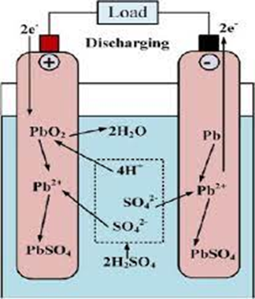
Discharging: When cell is operating as Galvanic cell then it is said to be discharging.
Anode: [Lead (-ve)]
Pb(s) → Pb⁺² + 2e⁻
Pb⁺² + SO₄⁻² → PbSO₄(s) ↓
Cathode: (PbO₂ (+ve)]
PbO₂(s) + 2H⁺ (aq) + 2e⁻ → Pb⁺² + 2H₂O(l)
Pb⁺² + SO₄⁻² → PbSO₄(s) ↓
The total reaction can be written:
Pb(s) +PbO₂(s) + 4H⁺ +SO₄⁻² →2PbSO4(s) +2H₂O(l) +E

Slide 38
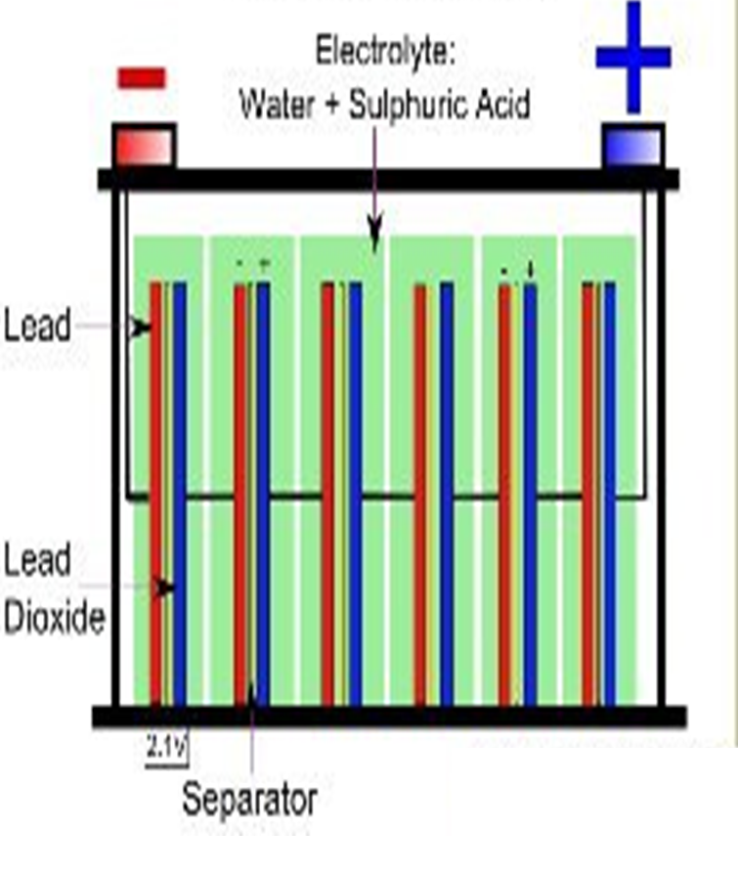
Charging: When both anode and cathode are covered by PbSO₄, the cell ceases to function as voltaic cell. The cell is then recharged by passing external emf greater than the cell emf (2volts). Then reverse of the discharging reactions takes place and anode become cathode and cathode become anode.
Reaction at Cathode [Pb (-ve) ]:
Cathode: PbSO₄(s) +2e⁻ → Pb(s) + SO₄⁻²
Reaction at anode [PbO2 (+ve)]:
Anode:PbSO₄(s) + 2H₂O(l) +2e- →PbO2(s) +4H⁺ +SO₄⁻²
The total reaction can be written:
2PbSO₄(s) + 2H₂O(l) +E →Pb(s) + PbO2(s) +4H⁺ + SO₄⁻²
During charging the electrodes restore their original conditions and the conc. of H₂SO₄ increases, while during discharging the conc. of H₂SO₄ decreases.

Slide 39
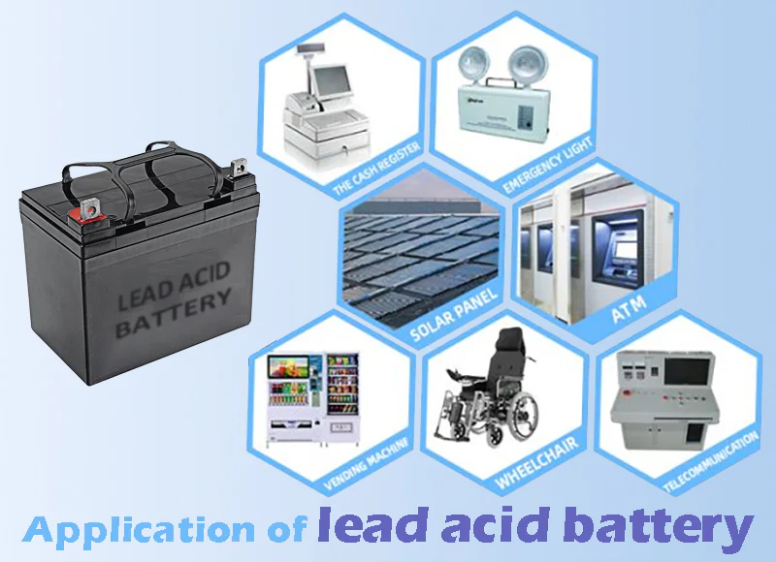
Disadvantages
If the cell voltages exceed 2.39V, the water breaks down into H₂ and O₂ and may lead to explosion.
Fumes from the acid solution may have a corrosive effect on the area surrounding the battery.
These cells have a low life , a quick self discharge and low energy densities.
Uses: Electrical vehicles, gas engine ignition and telephone exchanges.

Slide 40
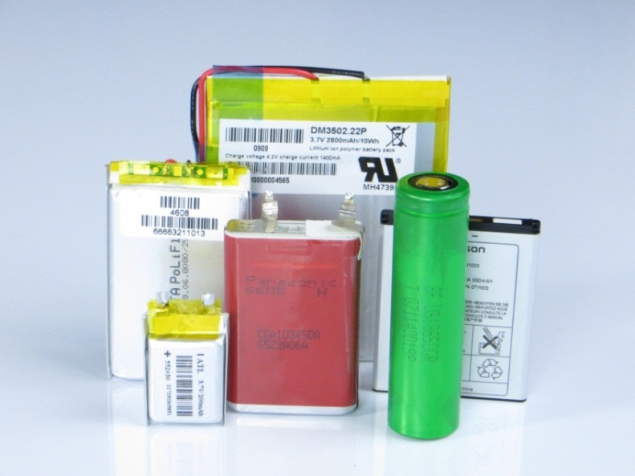
Lithium-ion battery
This battery composed of Lithium, the lightest metal and highest electrochemical potential metal.
The energy density of Li-ion battery is more. The nominal cell potential is of single cell is 3.6 volts.
Lithium, however, is an unstable metal, so Lithium-Ion batteries are made from Lithium ions from other chemicals.
In addition, Lithium-Ion batteries have no poisonous metals, such as lead, mercury or cadmium.
So lithium-ion batteries are ideal for portable devices.

Slide 41
A Lithium ion battery is a type of rechargeable battery in which intercalated Li compounds are used as the electrode materials.
The cell reactions are reversible and works like Galvanic cell as well Electrolytic cell.
Components of Lithium-ion battery:
A negative electrode plate: Graphitic carbon usually denoted as C₆, which acts as host solid electrode.
A positive electrode plate: It is made from lithium liberating compounds such as lithium cobalt oxide (LiCoO₂), lithium manganese oxide (LiMn₂O₄), lithium nickel oxide (LiNiO₂) etc.
A separator: Micro porous polyethylene membrane.
Electrolyte: Lithium hexa fluoro phosphate(LiPF₆) or Lithium tetra fluoro borate (LiBF₄) dissolved in Organic solvents.

Slide 42
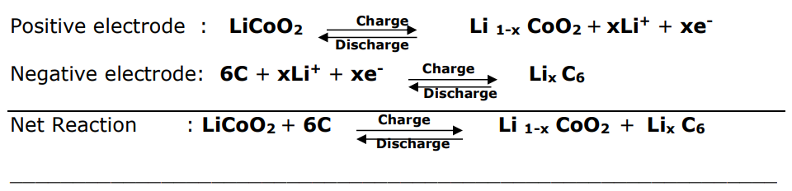
Chemistry during Charging and Discharging
The process of lithium ions moving into negative electrode (C₆) from the positive electrode (LiCoO₂) is known as insertion or intercalation.
Charging: During charging, the lithium ions are extracted from the positive electrode and inserted into the negative electrode.
The positive electrode compensates the removal of lithium ions by the oxidation of its transition metal (Co³⁺ → Co⁴⁺).
Discharging: During the discharge, the lithium ions are travel from the negative electrode through the electrolyte back to the positive electrode.
The positive electrode accepts lithium ions by the reduction of its transition metal (Co⁴⁺ → Co³⁺).

Slide 43
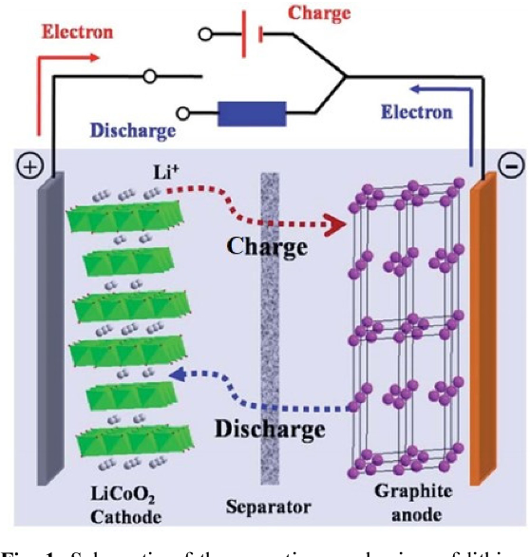
Advantages
These have high energy density than other batteries and low weight.
They produce high voltage out about 4V.
No liquid electrolyte means they are immune from leaking.
Fast charge and discharge rate
Disadvantage
They are expensive. Deep discharge reduces the life cycle.
It should be maintained with in safe voltage and current limits.
It should be often fully charged to prevent crystalline aging.
Restriction for transport due safety issue.
APPLICATIONS:
Mobile phones: 55% of total production.
Notebook PC’s: 25% of total production.
Cameras, Camcorders, MP3, Games, etc.: ~ 20% of total production.

Slide 44
Fuel cells or Flow batteries
A fuel cell is an electrochemical cell, converts chemical energy of a fuel and oxidant into electrical energy.
The principle of fuel cell is same as that of the electro chemical cell, only difference is, the fuel and oxidant stored outside the cell.
These are also primary cells, but the electricity can be generated as long as the fuel and oxygen are supplied into the cell.
This cell consists of a liquid electrolyte sandwiched between the two porous electrodes.
Porous electrodes are used in fuel cells to provide a large surface area.
A catalyst such as Pt, Pd, Mg or Ni is often used to initiate and speed up the reactions.
There is no combustion involved. Oxidation of the hydrogen takes place electrochemically.
It is highly eco-friendly i.e. there is no harmful product.
Example: H₂-O₂ Fuel cell and CH₃OH-O₂ Fuel cell.

Slide 45
There are basically five fuel cell types.
1. Proton exchange membrane fuel cells (PEMFC)
2. Alkaline fuel cells (AFC)
3. Phosphoric acid fuel cells (PAFC)
4. Molten carbonate fuel cells (MCFC)
5. Solid oxide fuel cells (SOFC)
 | PEMFC | AFC | PAFC | MCFC | SOFC
Electrolyte | Ion Exchange Membranes | Potassium Hydroxide | Phosphoric Acid | Molten Carbonate | yttrium-stabilized zirconia
Operating Temperature | 80°C | 120°C -150°C | 200°C | 650°C | 800-1000°C
Charge Carrier | H⁺ | OH⁻ | H⁺ | CO₃⁻² | O⁻²
Catalyst | Platinum | Platinum | Platinum | Nickel | Nickel
Water formation | Cathode | Anode | Cathode | Anode | Anode
Fuel | Pure H₂ (tolerates CO₂) | Pure H₂ | Pure H₂ (tolerates CO₂, 1.5% CO) | H₂, CO, CH₄, other hydrocarbons (tolerates CO₂) | H₂, CO, CH₄, other hydrocarbons (tolerates CO₂)
Electrical Efficiency | 35% | 40-60% | 40-50% | 50-60% | 50-65%

Slide 46
Hydrogen-Oxygen fuel cell
The H₂−O₂ fuel cell uses a pure hydrogen gas as fuel and is a alkali fuel cell.
The cell consists of two porous carbon electrodes impregnated with a finely divided platinum or nickel as catalyst with an electrolyte of 25−40% KOH.
The cell develops an emf of ~1.23V. The efficiency of H₂–O₂ cell is 70%.
The cell may be represented as: C, Pt or Ni / KOH / C, Pt or Ni.
In H₂−O₂ fuel cell, the pure hydrogen gas is supplied through anode and O₂ gas is supplied through the cathode.
Presence of Pt (or) Ni catalyst initiates the oxidation of H₂ gas and makes to split up into H⁺ ions and electrons.
These electrons are travel to the cathode through an external source to produce electric current.
The H⁺ ions migrate towards cathode through the electrolyte and get reduced into H₂O in presence of O₂.

Slide 47
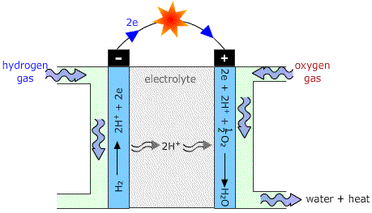
Cell reactions:
At anode : 2H₂(g) + 4OH⁻ (g) → 4H₂O(l) + 4e-
At cathode : O₂(g) + 2H₂O(l) + 4e- → 4 OH⁻(aq)
Net reaction: 2H₂(g) + O₂(g) → 2H₂O(l)+ E.
Advantages
Hydrogen and oxygen are readily available.
It does not pollute the environment.
It is used to power rockets.
A hydrogen fuel cell is a renewable energy source.
Release less heat, so can be used in military applications.
Applications:
Used in space vehicles, submarines or ot military-vehicles.
Light weight-cells are preferred for space crafts.
Product water valuable source of fresh water to astronauts.

Slide 48
Methanol – Oxygen fuel cell
Direct methanol fuel cells (DMFCs) are a type of proton-exchange membrane fuel cells (PEMFCs).
Carbon rods impregnated with Platinum are used as electrodes. Polymeric proton exchange membrane is used as electrolyte.
In fuel methanol and water supplied to the anode. The methanol molecule's carbon-hydrogen, and oxygen-hydrogen bonds are broken to generate electrons and protons.
Water molecule's oxygen-hydrogen bond is also broken to generate an electron and proton.
The carbon from the methanol and the oxygen from the water combine to form carbon dioxide.
Oxygen from air (supplied to the cathode) is simultaneously reduced at the cathode.
The positive ions (H⁺) are transferred across the proton exchange membrane to the cathode where they react with oxygen to produce water.
Electrons are transported through an external circuit from anode to cathode, providing power to a connected device.

Slide 49
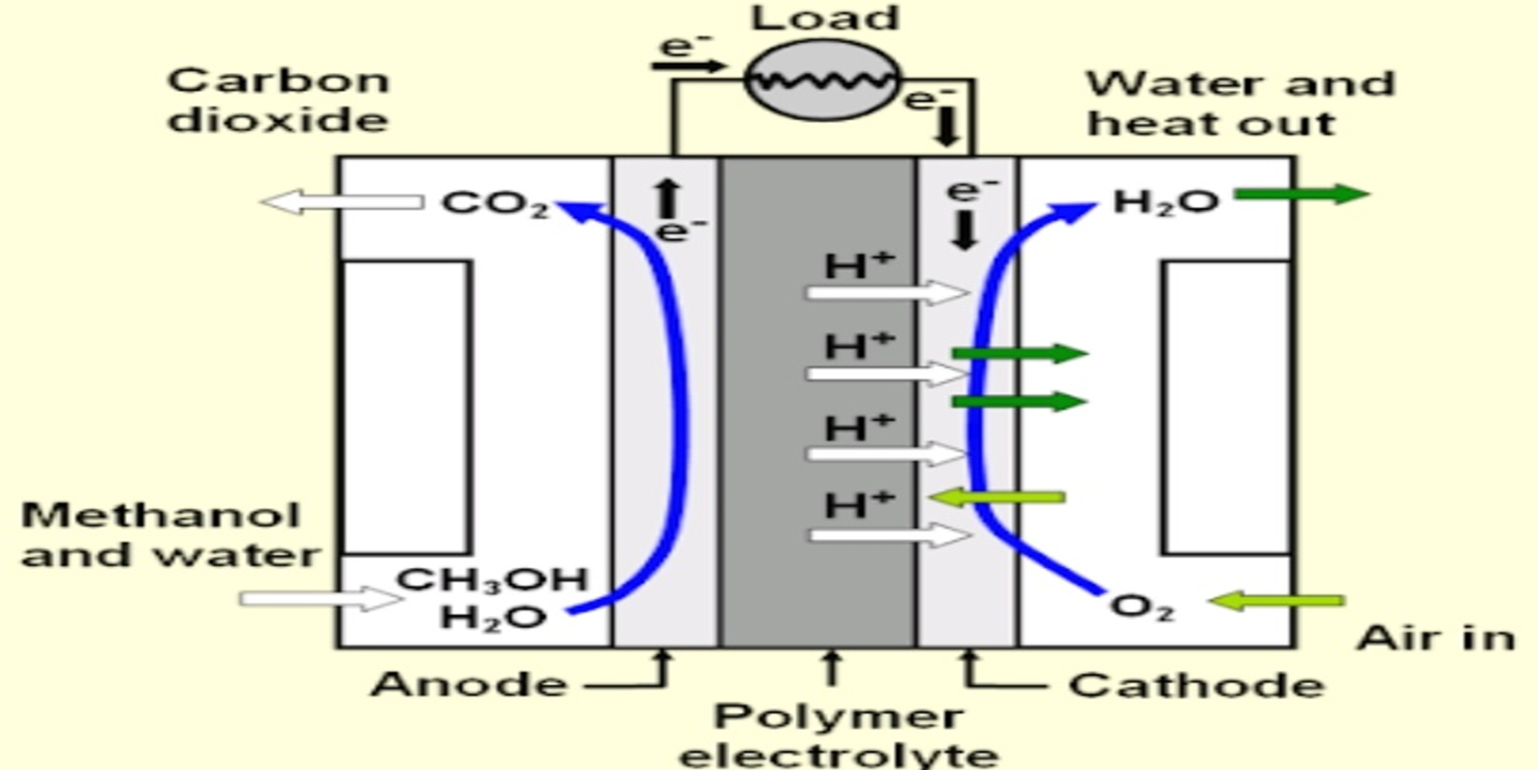
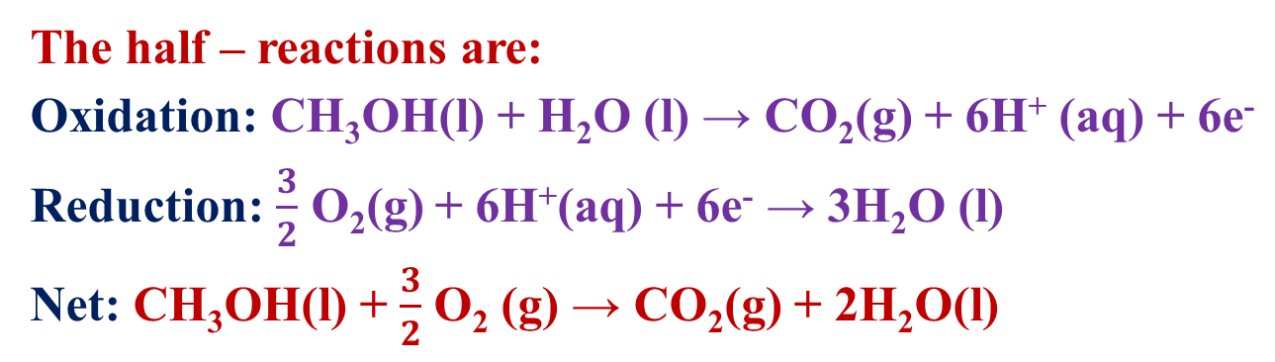
The half – reactions are:
Oxidation: CH₃OH(l) + H₂O (l) → CO₂(g) + 6H⁺ (aq) + 6e⁻
Reduction: $\frac{3}{2}$ O₂(g) + 6H⁺(aq) + 6e⁻ → 3H₂O (l)
Net: CH₃OH(l) + $\frac{3}{2}$ O₂ (g) → CO₂(g) + 2H₂O(l)
Application
Current DMFCs are limited in the power they can produce, but can still store a high energy content in a small space.
Military applications of DMFCs are an emerging application since they have low noise and thermal signatures and no toxic effluent.
They can produce a small amount of power over a long period of time. This makes them suited for powering large vehicles, but ideal for smaller vehicles.

Slide 50
Advantages and Disadvantages of Fuel Battery
Advantages:
High Efficiency- when utilizing co-generation, fuel cells can attain over 80% energy efficiency.
Good reliability- quality of power provided does not degrade over time.
Noise- offers a much more silent and smoother alternative to conventional energy production.
Environmentally beneficial- greatly reduces CO₂ and harmful pollutant emissions.
Size reduction- fuel cells are significantly lighter and more compact.
Disadvantages:
Expensive to manufacture due the high cost of catalysts (platinum).
Lack of infrastructure to support the distribution of hydrogen.
The currently available fuel cell technology is in the prototype stage and not yet validated.
Hydrogen is expensive to produce and not widely available.

Slide 51
Long Answer questions:
Discuss various types of conductance with units. Interpret effect of dilution on specific, equivalent and molar conductance.
Derive Nernst equation and write its applications.
What is single electrode potential? Sketch one method to determine single electrode potential.
Summarize metal-metal insoluble salt electrode.
Illustrate the method of P^{H} measurements with help of Quinhydrone electrode.
What are Ion selective electrode? How glass electrode useful to determine concentration of species in a mixture?
Write a detailed notes on Dry cell.
Describe working principle of lead acid storage battery.
How Lithium ion battery is different from traditional batteries?
Schematize Hydrogen-Oxygen fuel cell with neat diagram.

Slide 52
Short Answer questions:
Compare specific, equivalent and molar conductance.
Differentiate Electronic conductors from Electrolytic conductors.
Define EMF and cell notation.
Distinguish Electrolytic cell from Electrochemical cell.
State Electrochemical series with example.
Discriminate primary reference electrodes from secondary reference electrode.
What are drawbacks of Quinhydrone electrode.
Differentiate primary, secondary and flow batteries.
What are advantages of Lithium batteries?
How lithium batteries different from traditional batteries?
How internal combustion engines different from Fuel cells?
Write advantages and disadvantages of fuel batteries.
What is intercalation mechanism?

